Slide 1

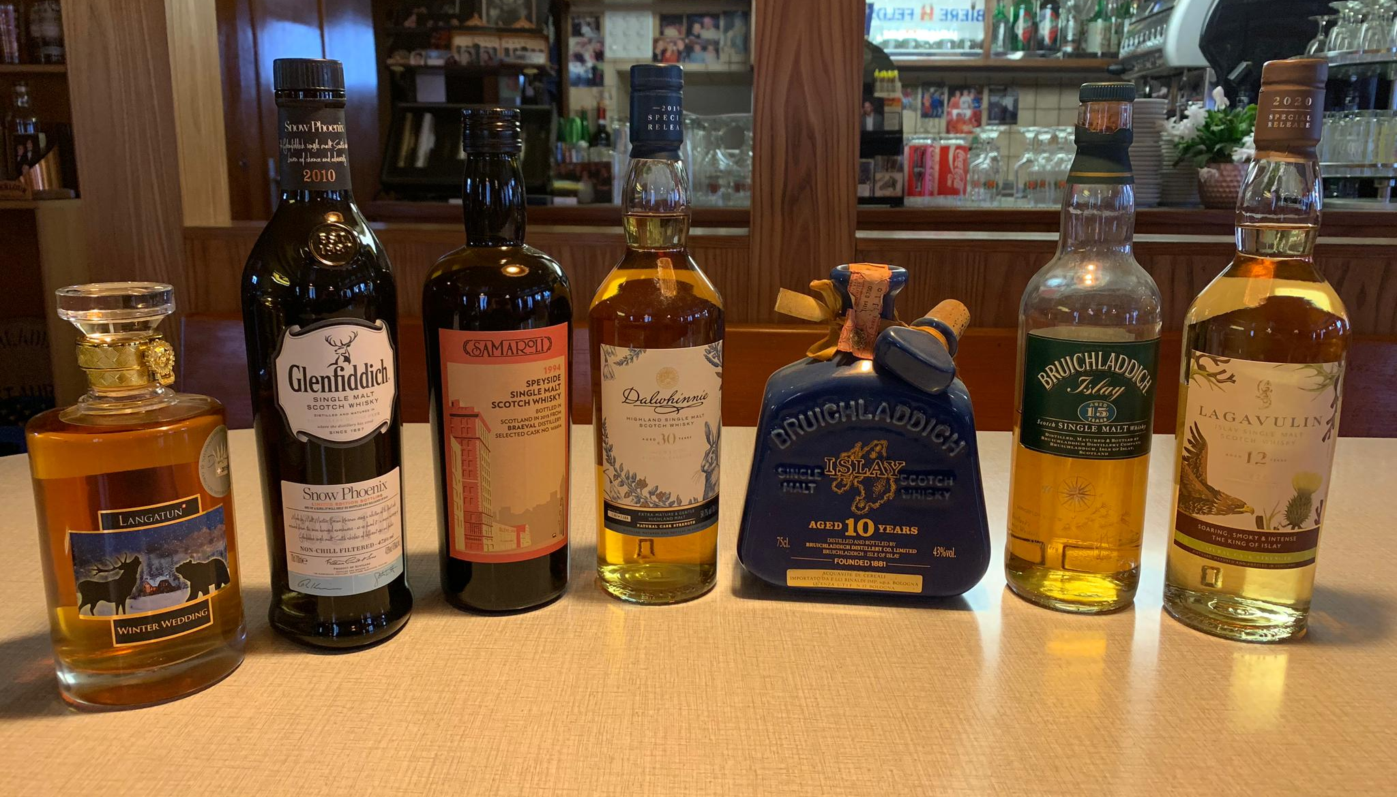
SEVENTEEN DRAMS
ONLINE TASTING 8. Dez 2020

Slide 2
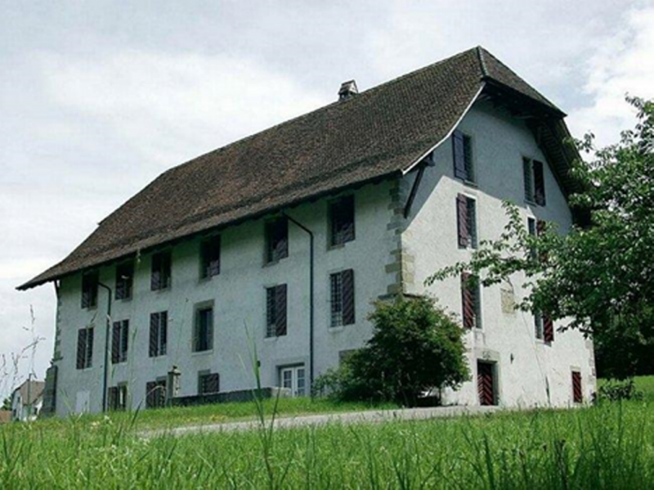
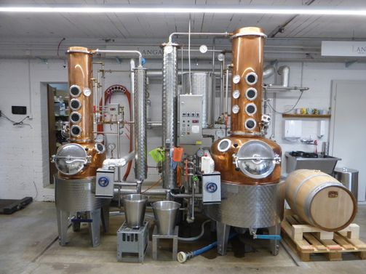
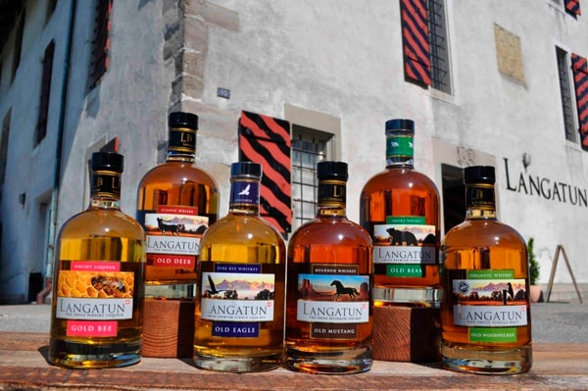
SEVENTEEN DRAMS
langatun Estd. 1857 Aarwangen, schweiz

Slide 3
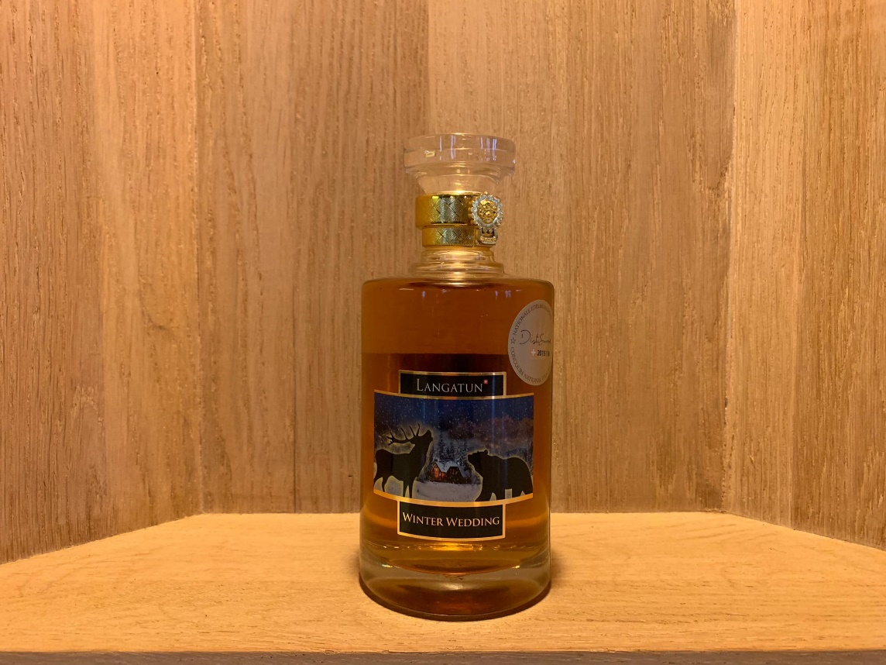
SEVENTEEN DRAMS
Langatun winter wedding 46% wedding between «old deer» & «old bear»

Slide 4
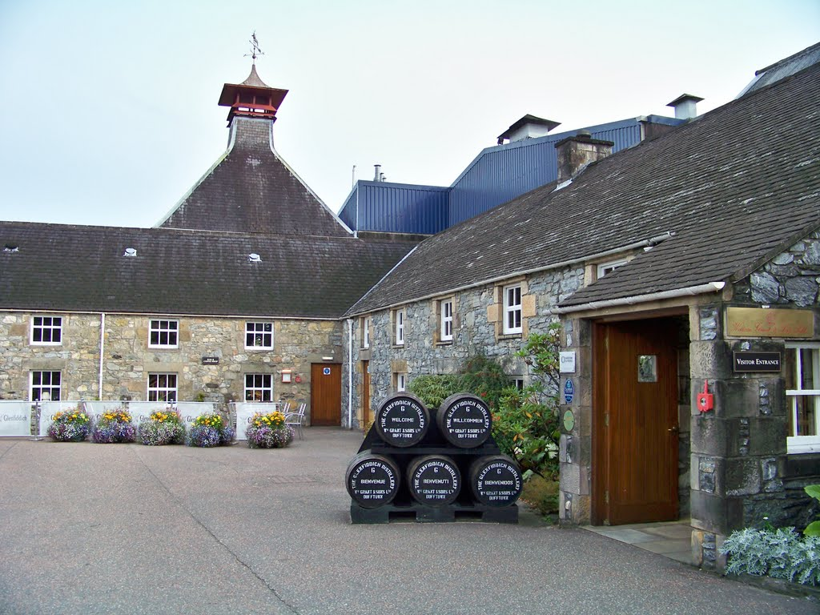
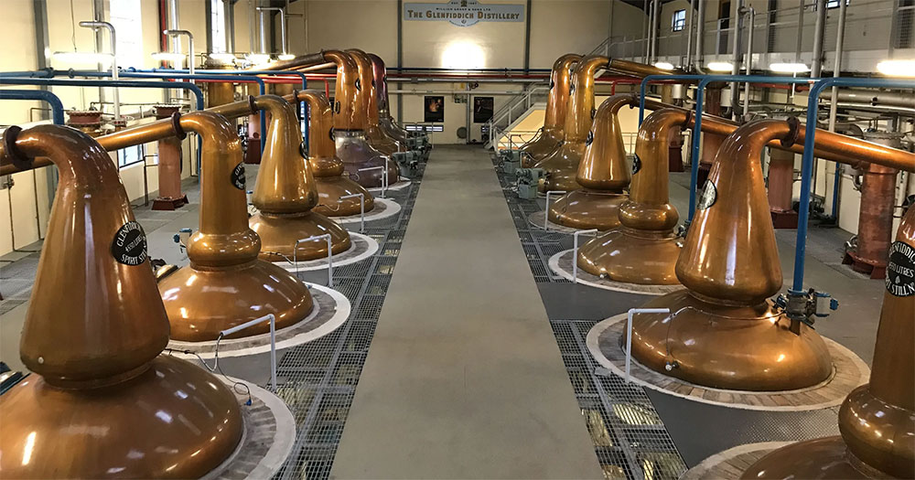
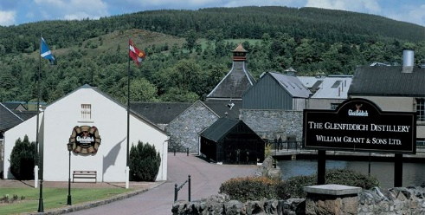
SEVENTEEN DRAMS
glenfiddich Estd. 1886/87 Speyside

Slide 5
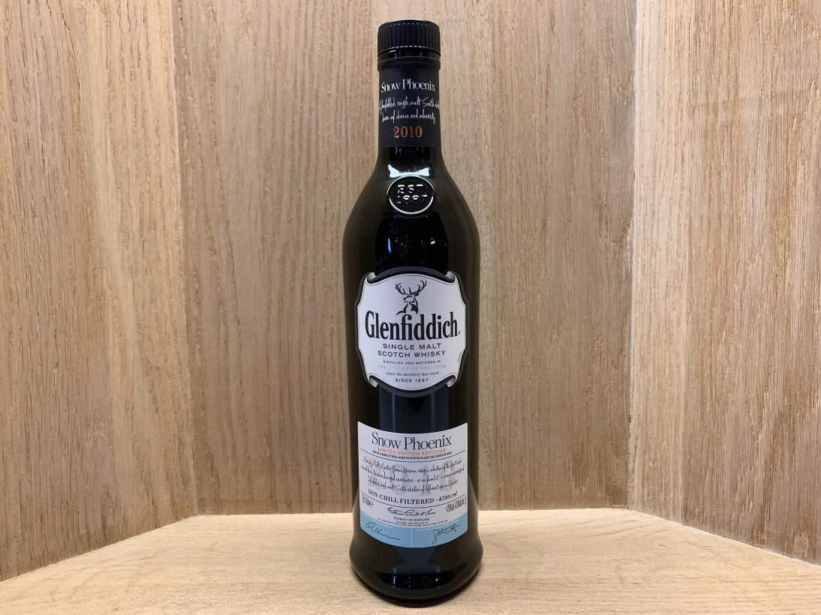
SEVENTEEN DRAMS
Glenfiddich snow phoenix Limited edition 1 of 12’000 Bottles 47.6%

Slide 6
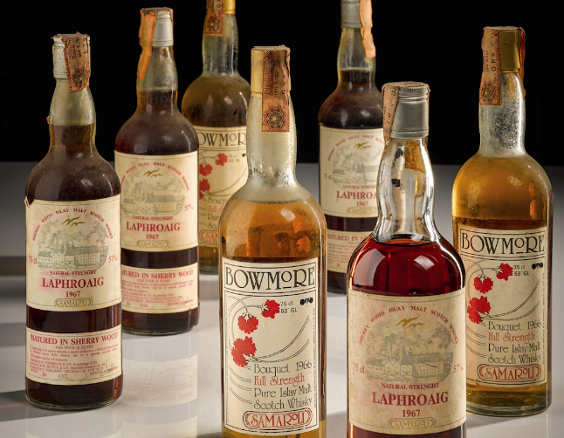
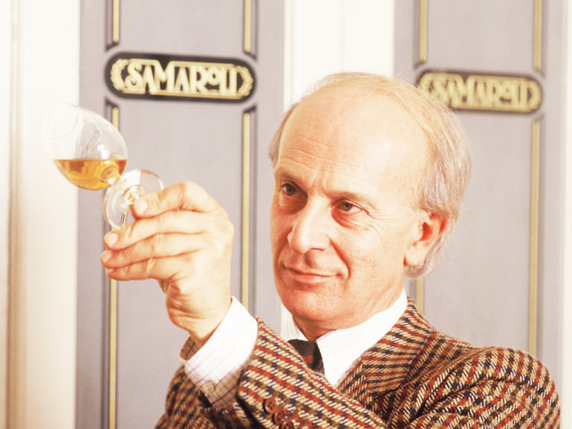


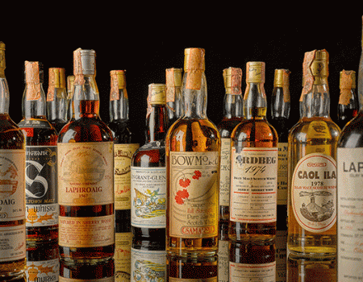
SEVENTEEN DRAMS
samaroli Estd. 1968 Rom, italy

Slide 7
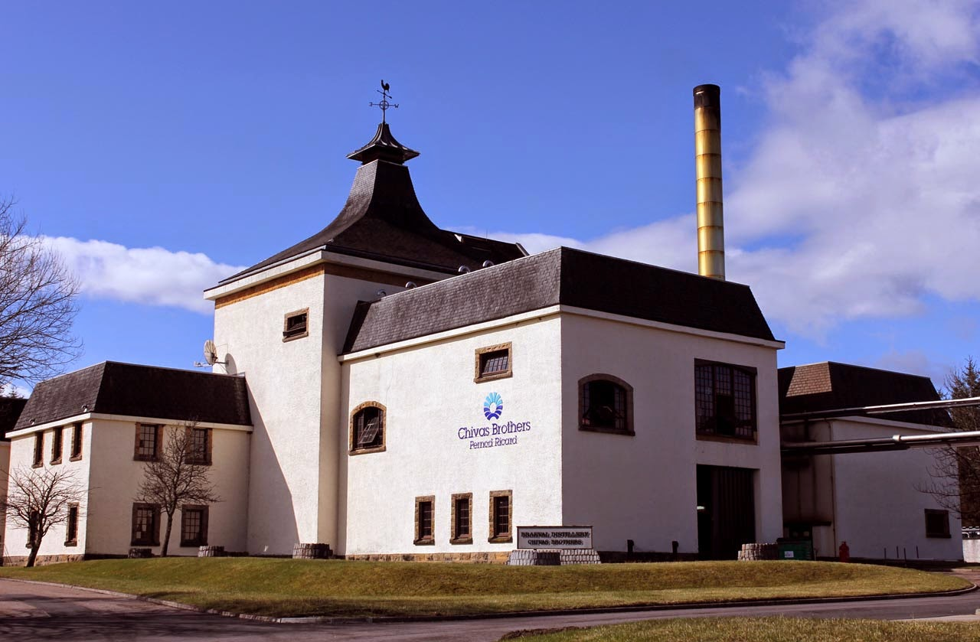
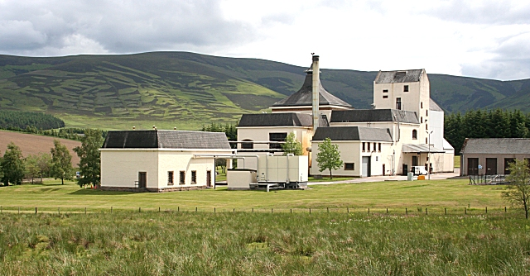
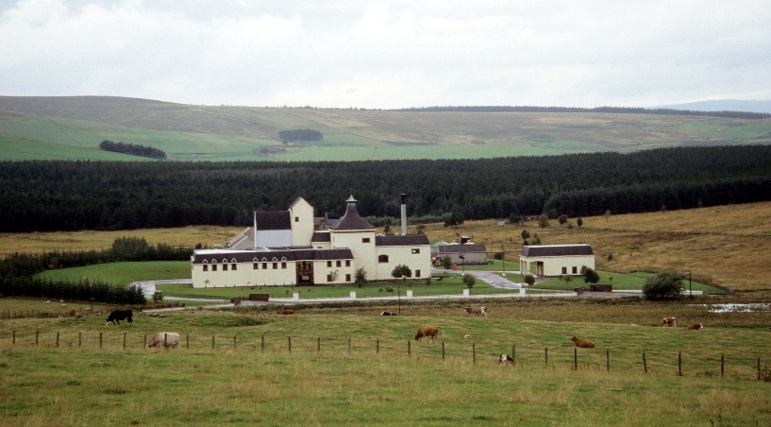
SEVENTEEN DRAMS
braeval Estd. 1973 Speyside

Slide 8
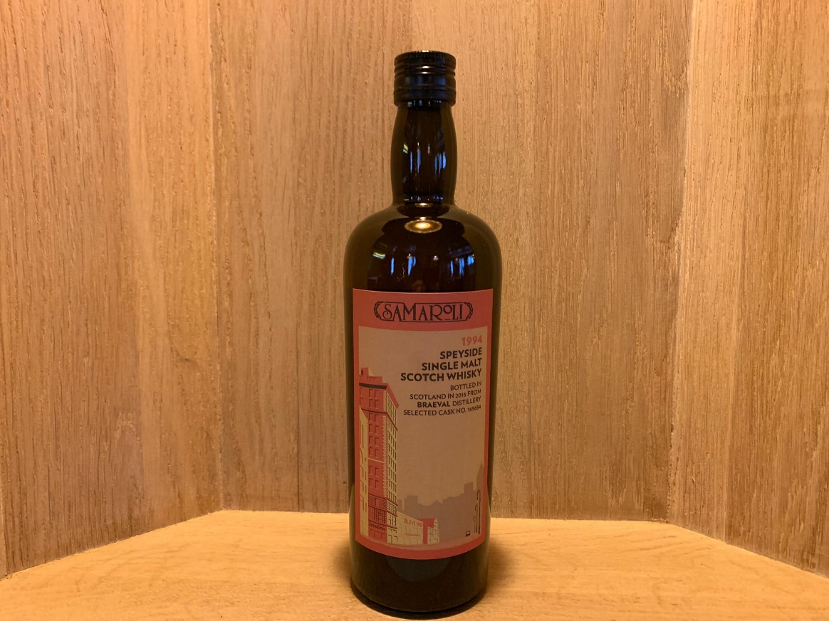
SEVENTEEN DRAMS
Samaroli braeval 21yo 1994/2015 cask no. 165654 1 of 240 bottles 45%

Slide 9
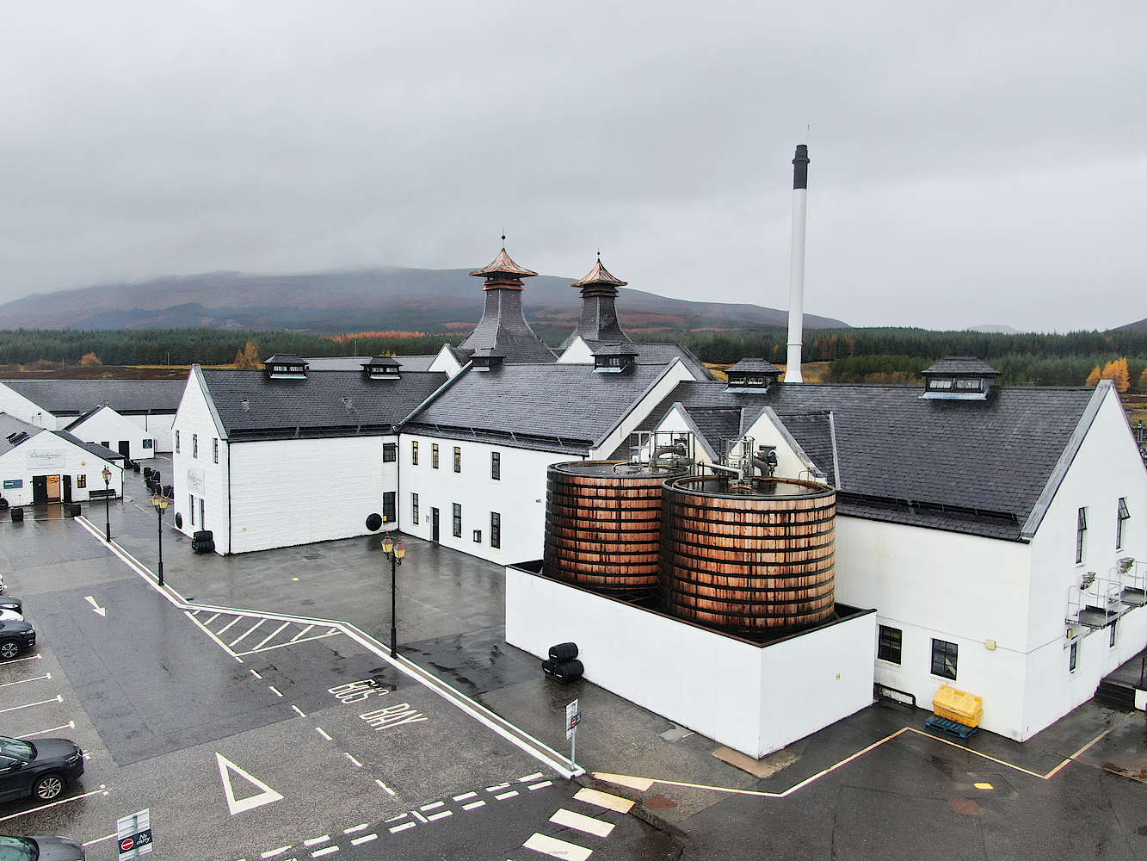
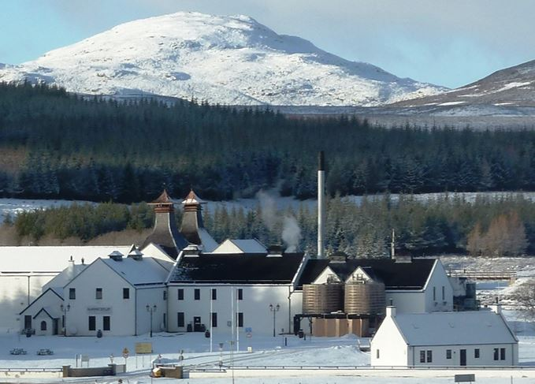
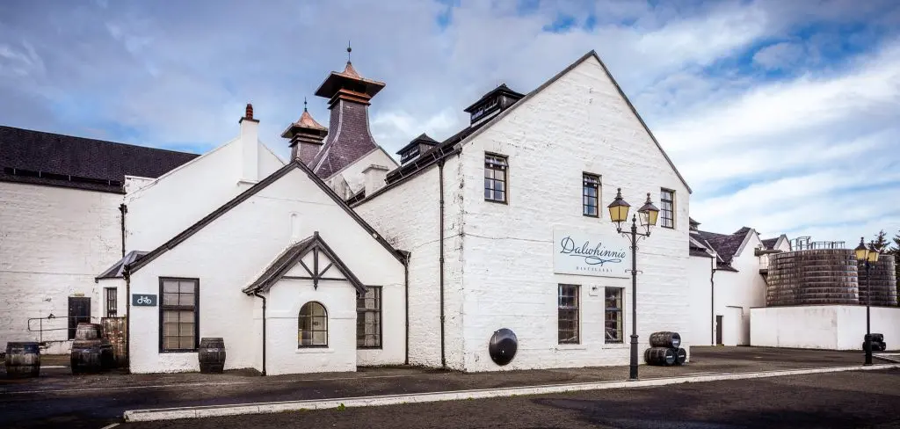
SEVENTEEN DRAMS
Dalwhinnie Estd. 1897 highlands

Slide 10
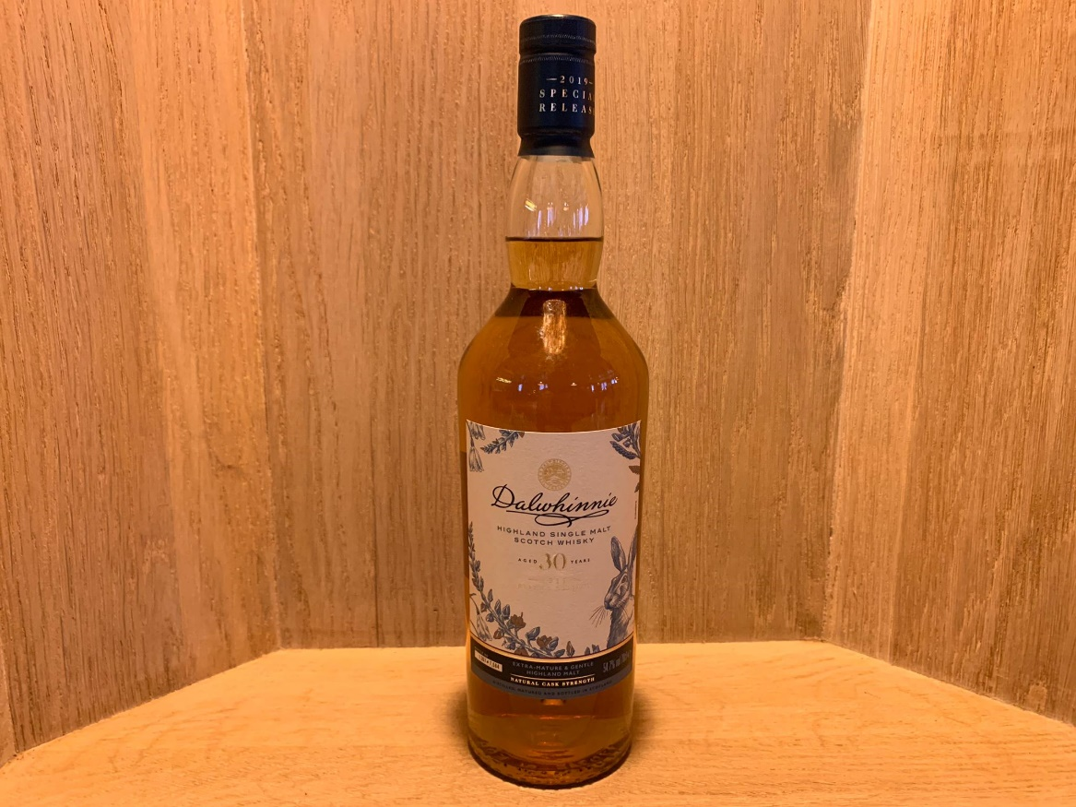
SEVENTEEN DRAMS
Dalwhinnie 30yo 54.7% special release 2019 1 0f 7’586 bottles bottles

Slide 11
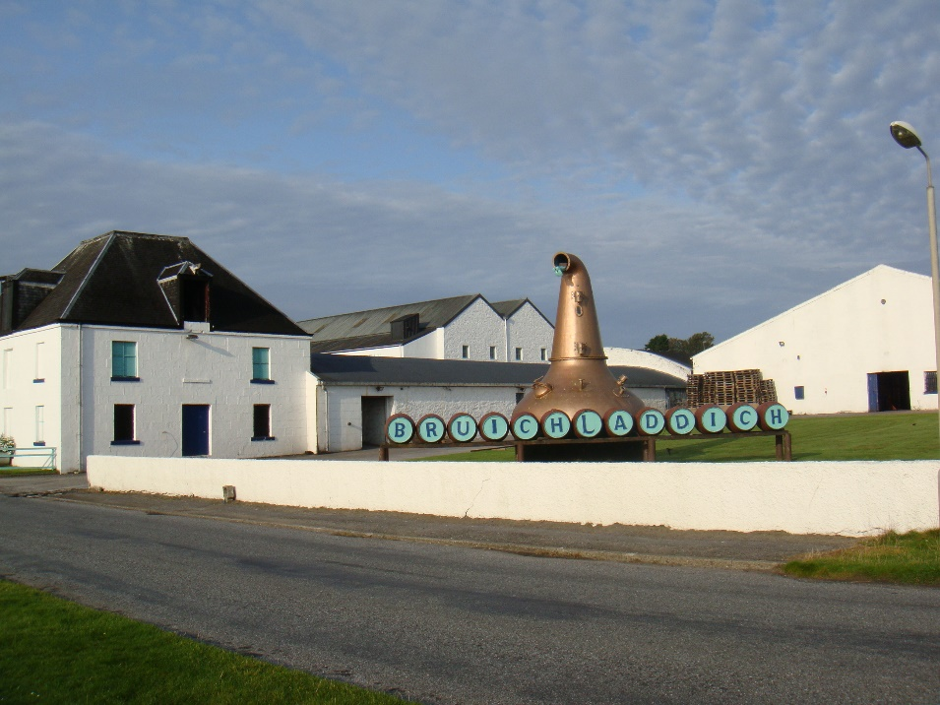
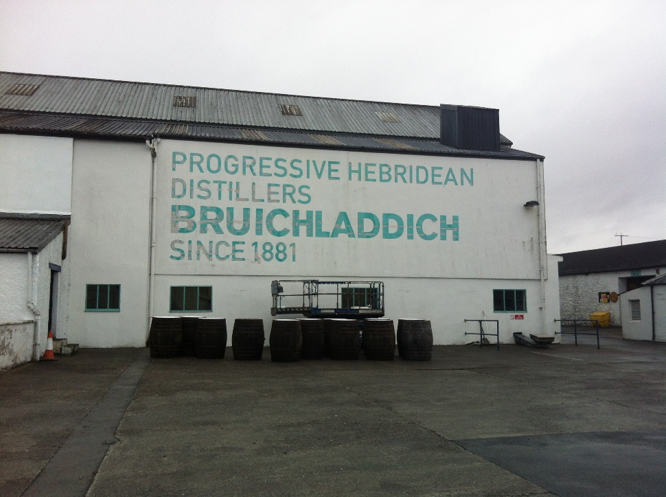
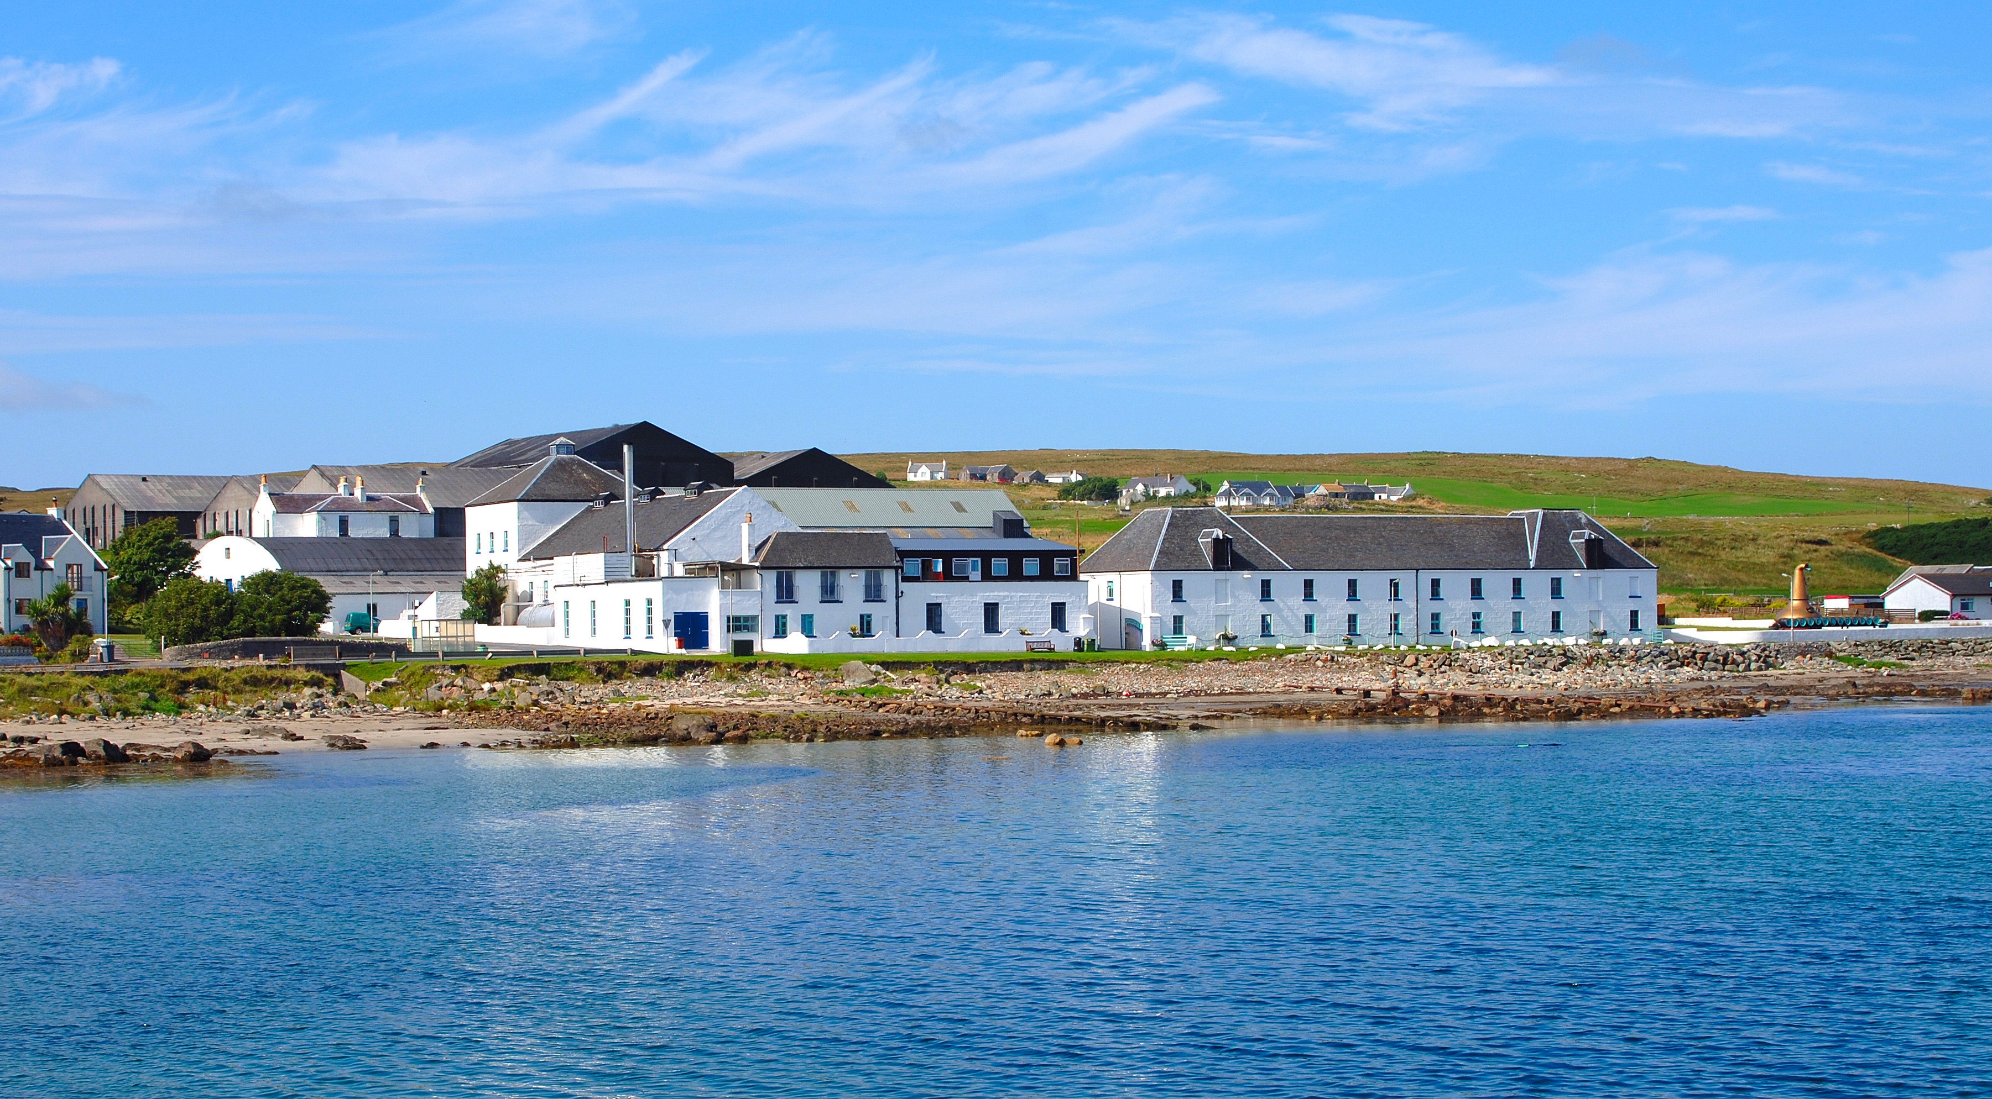
SEVENTEEN DRAMS
bruichladdich Estd. 1881 Isle of islay

Slide 12
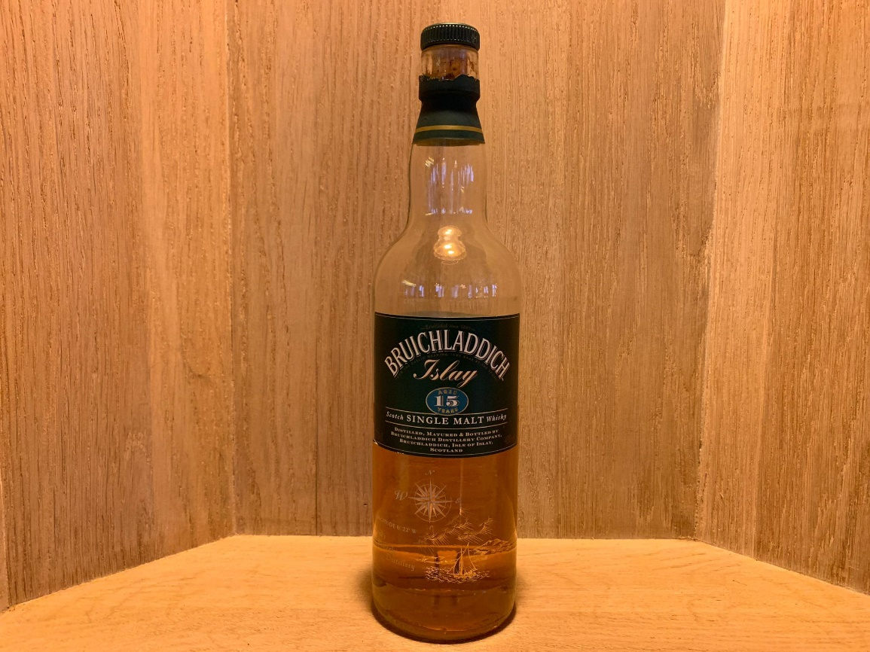
SEVENTEEN DRAMS
Bruichladdich 15yo bottled in the 90’s 43%

Slide 13
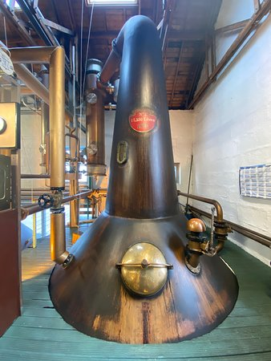
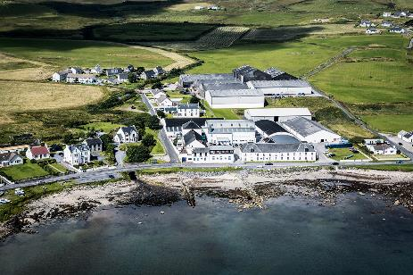
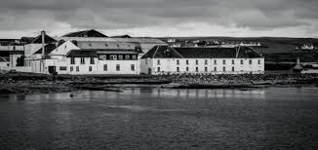
SEVENTEEN DRAMS
bruichladdich Estd. 1881
Isle of islay

Slide 14
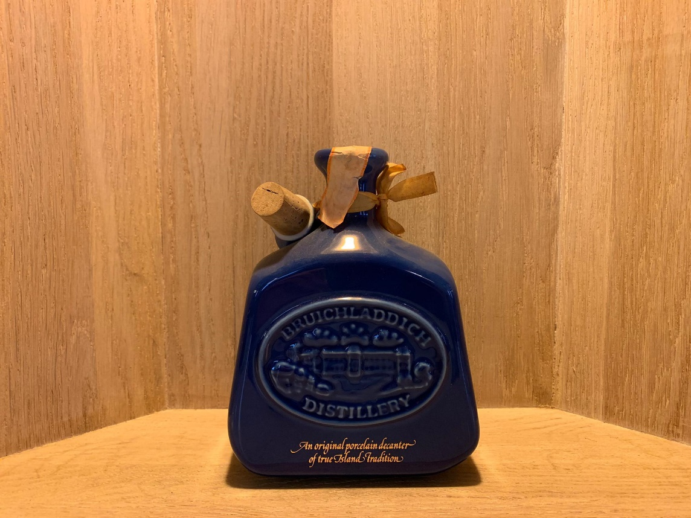
SEVENTEEN DRAMS
Bruichladdich 1oy 43% blue ceramic decanter bottled in the 80’s

Slide 15
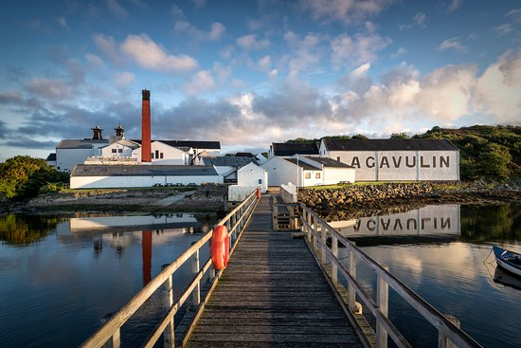
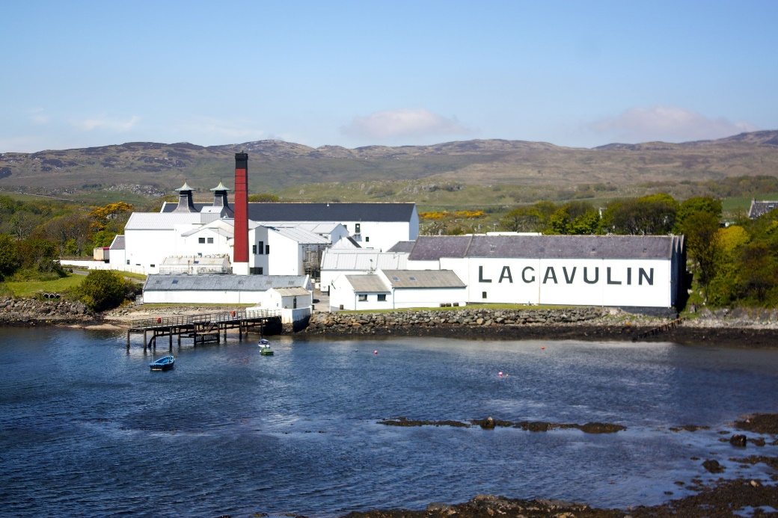
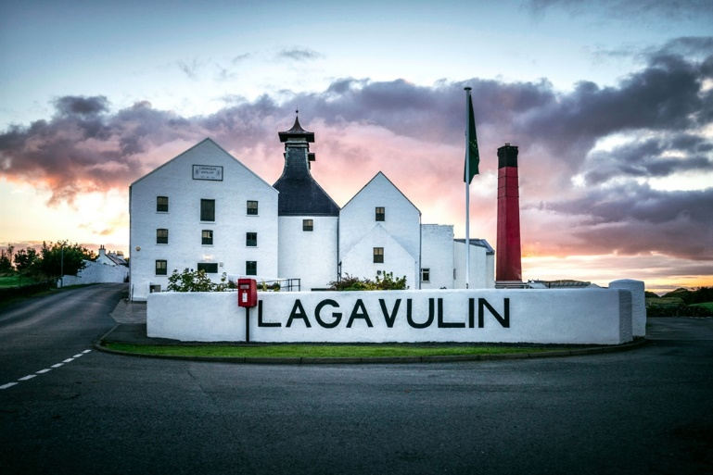
SEVENTEEN DRAMS
lagavulin Estd. 1816 Isle of islay

Slide 16
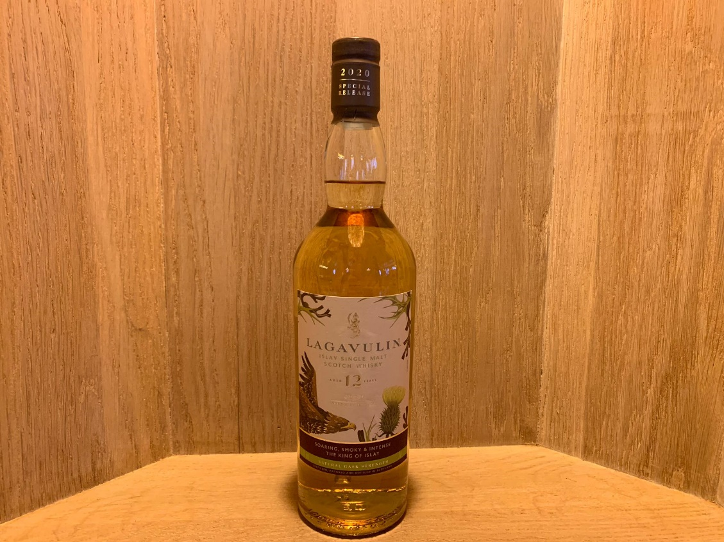
SEVENTEEN DRAMS
Lagavulin 12yo 56.4% special release 2020 1 of 60’762 bottles

