Slide 1

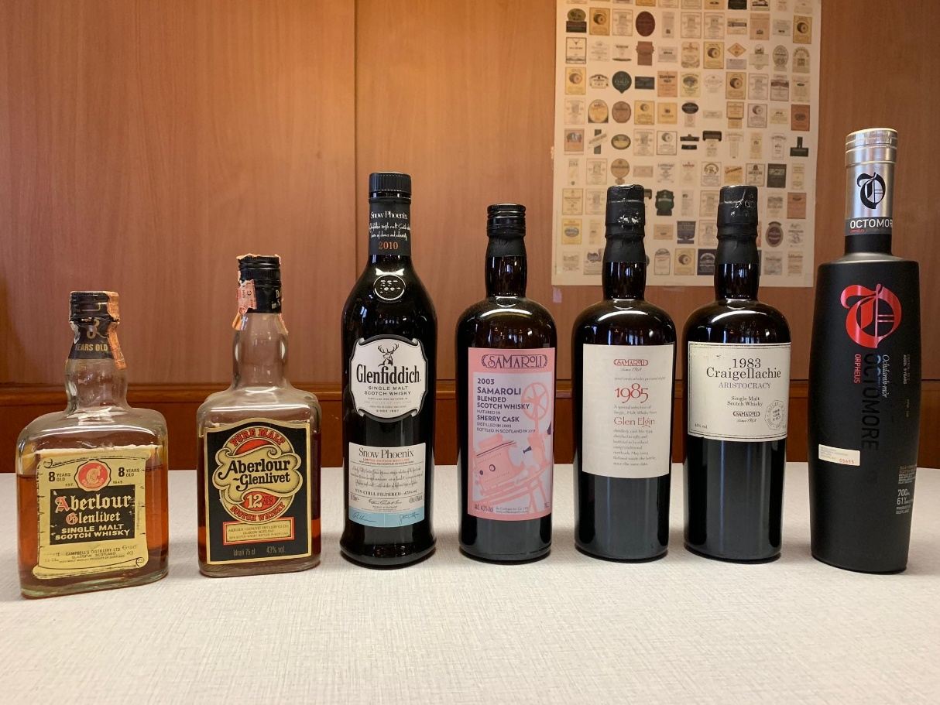
SEVENTEEN DRAMS
ONLINE TASTING 4. August 2020

Slide 2
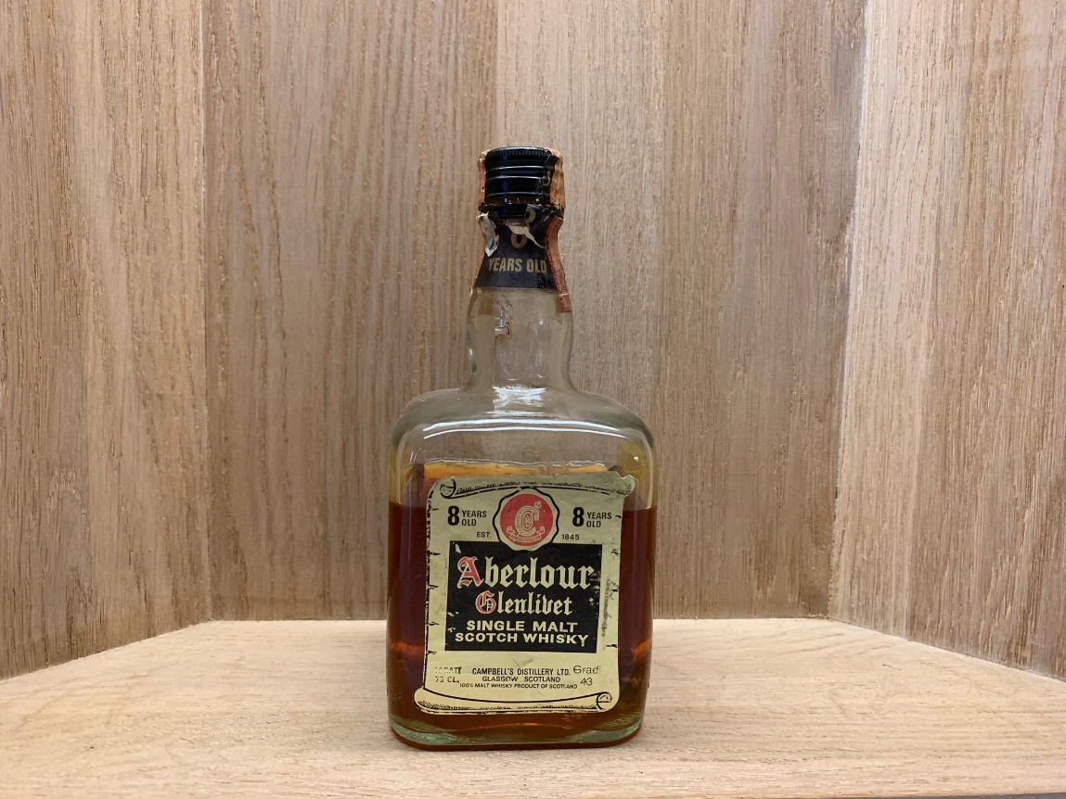
SEVENTEEN DRAMS
Aberlour-glenlivet 8Yo Bottled in the 80’s 43%

Slide 3
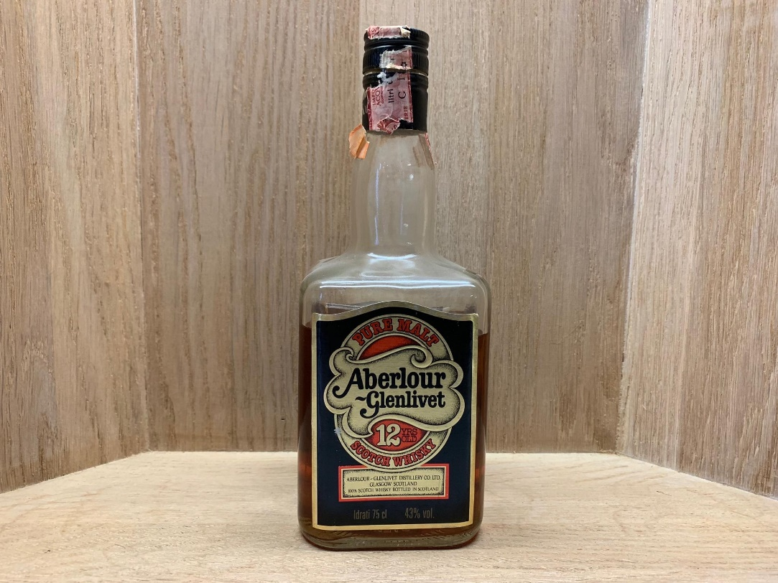
SEVENTEEN DRAMS
Aberlour-glenlivet 12yo bottled in the 80’s 43%

Slide 4
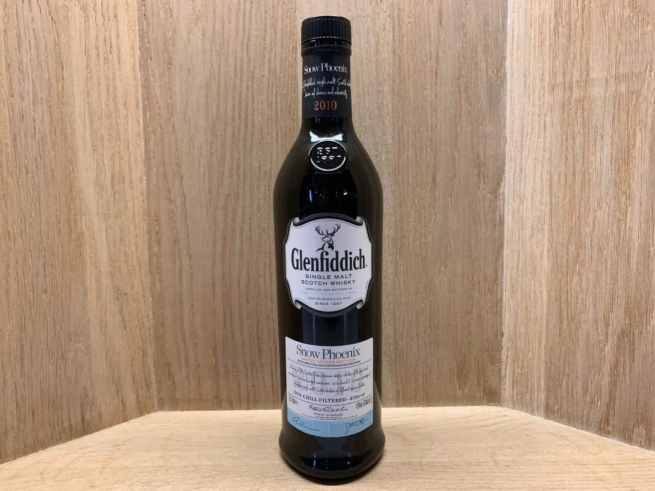
SEVENTEEN DRAMS
Glenfiddich snow phoenix
Limited edition 12’000 Bottles 47.6%

Slide 5
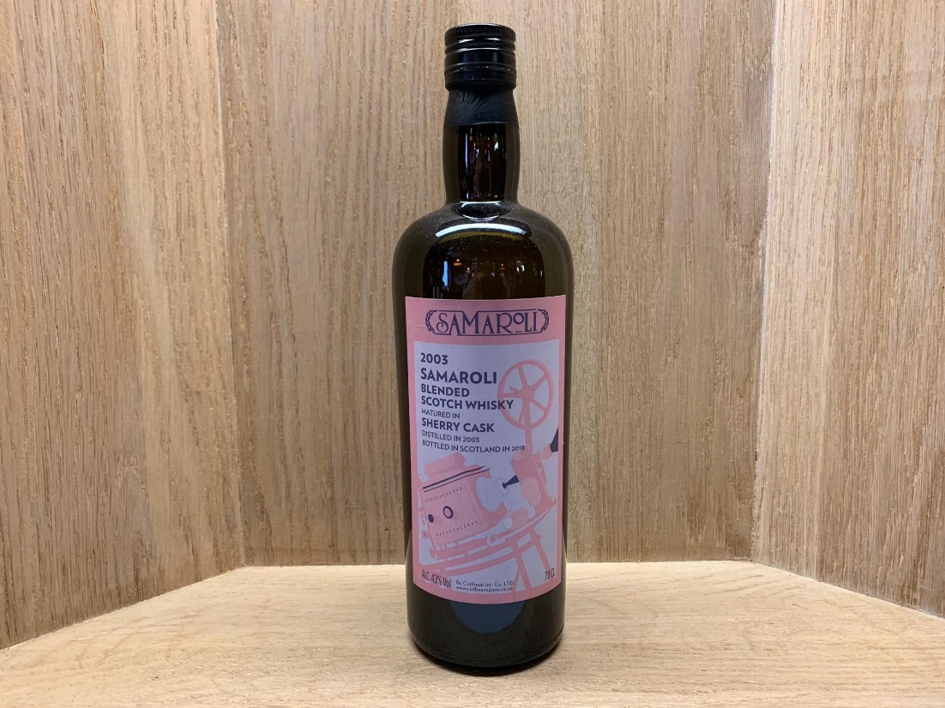
SEVENTEEN DRAMS
Samaroli blendet scotch whisky
2003/2018 sherry cask 43%

Slide 6
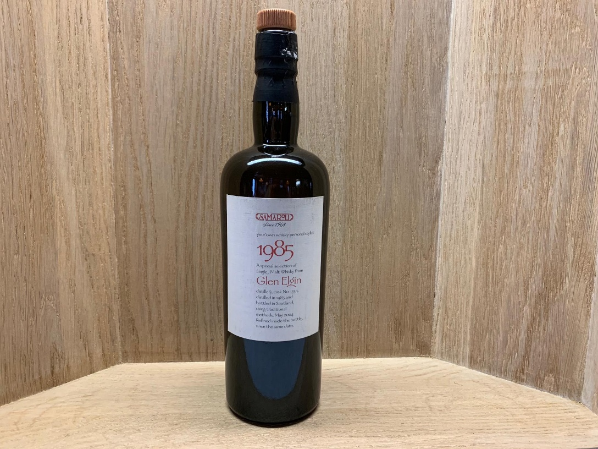
SEVENTEEN DRAMS
Glen elgin 1985 Samaroli
1985/2014 Cask No. 1534 45%

Slide 7
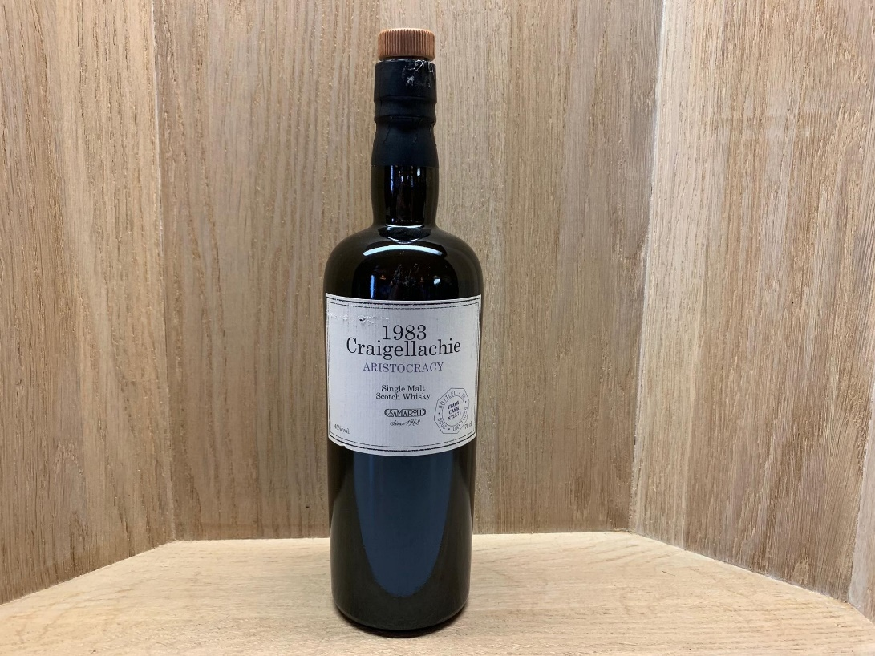
SEVENTEEN DRAMS
Craigellachie 1983 samaroli
1983/2006 Cask No. 2577 45%

Slide 8
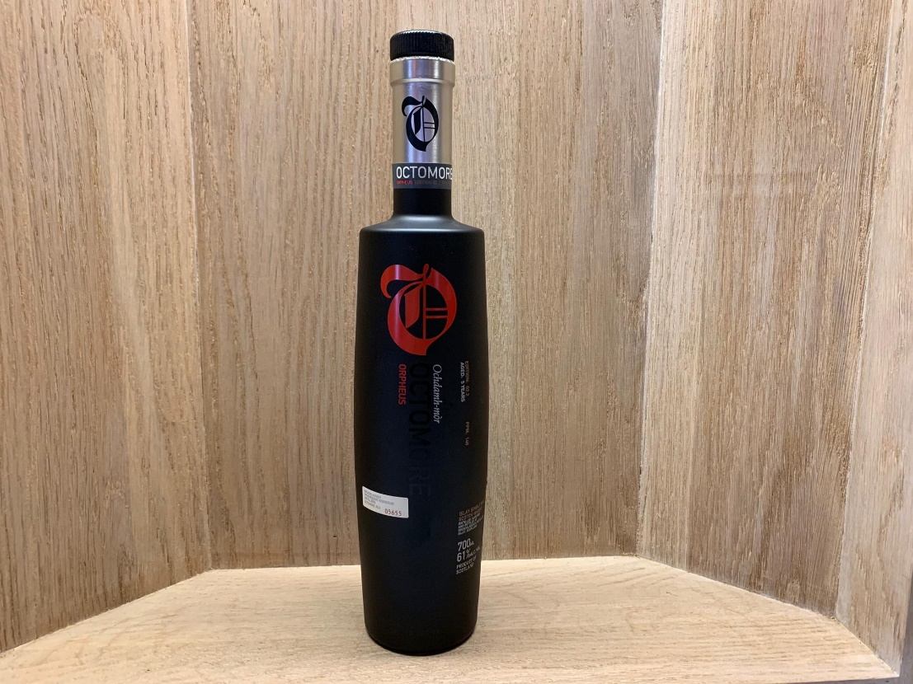
SEVENTEEN DRAMS
Octomore 02.2 Orpheus 5yo 140ppm
Bottle no. 05655 of 15’000 61%

